Slide 1
State Partisan Control affects on Covid
Project 1
Group 6

Slide 2
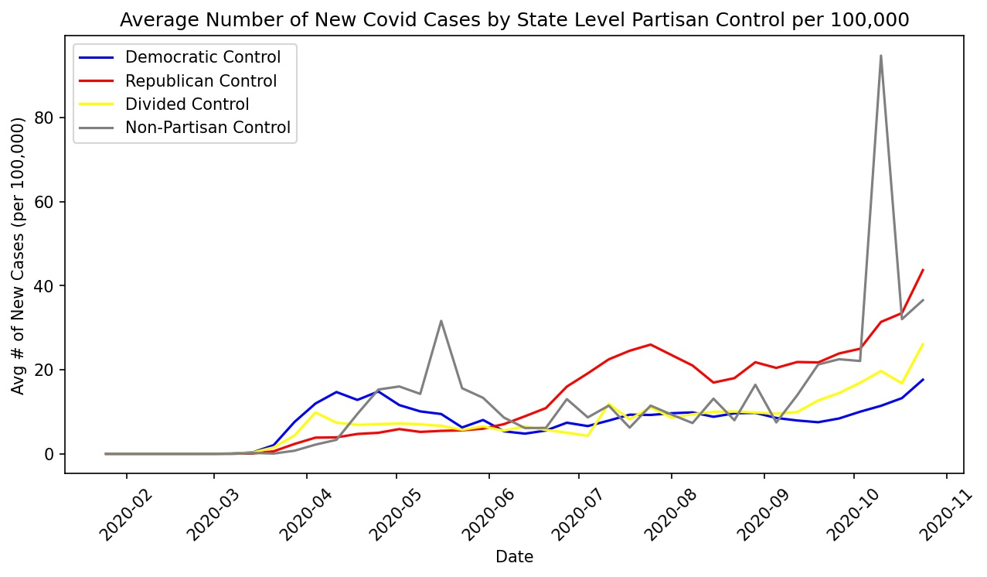
Covid Cases by State Partisan Control

Slide 3
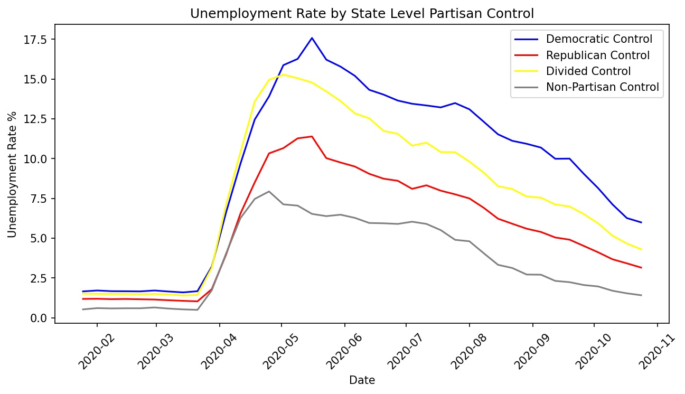
Unemployment Rate by State Partisan Control

